Slide 1

MQ2-GAS SENSOR
SIGNALS AND SYSTEMS
ECE104
SUBMITTED BY TEAM - 4
GIRINATH - 127004076
HARISH RAJ - 127004092
HARI - 127004087
EBI IMMANUAL - 127004069
BHUVAN - 127004086

Slide 2
BILL OF MATERIALS
S.No | Particulars | Cost (In Ruppees)
1 | MQ2-GAS SENSOR | 149
2 | ADC 0808 | 120
3 | STM32 MICROCONTROLLER
4 | OLED DISPLAY | 160
5 | BREADBOARD | 165
6 | WIRES | 50 (approx)
 | TOTAL

Slide 3

OVERVIEW
This project consists of building a gas sensor system. It begins
with a MQ2-GAS SENSOR, converting the sensed gas into voltage.
The output voltage of the sensor is directly fed into an ADC0808 analog-to-digital converter.
The ADC digitizes the analog signal, which is then interpreted by an STM32 microcontroller. Finally, the STM32 displays the data on an OLED Display.

Slide 4




BLOCK DIAGRAM
OLED
DISPLAY
SENSOR
ADC
MICRO
CONTROLLER

Slide 5
MQ2-SENSOR
WORKING:
Using an MQ sensor to detect a gas is very easy. You can either use the digital pin or the analog pin to accomplish this. Simply power the module with 5V and you should notice the power LED on the module to glow and when no gas it detected the output LED will remain turned off meaning the digital output pin will be 0V. Remember that these sensors have to be kept on for pre-heating time (mentioned in features above) before you can actually work with it.

Slide 6
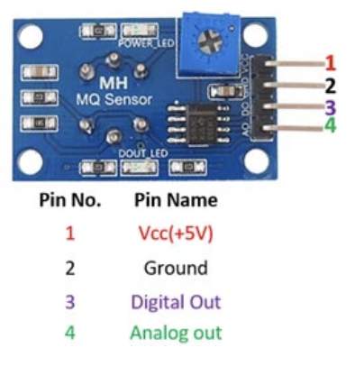
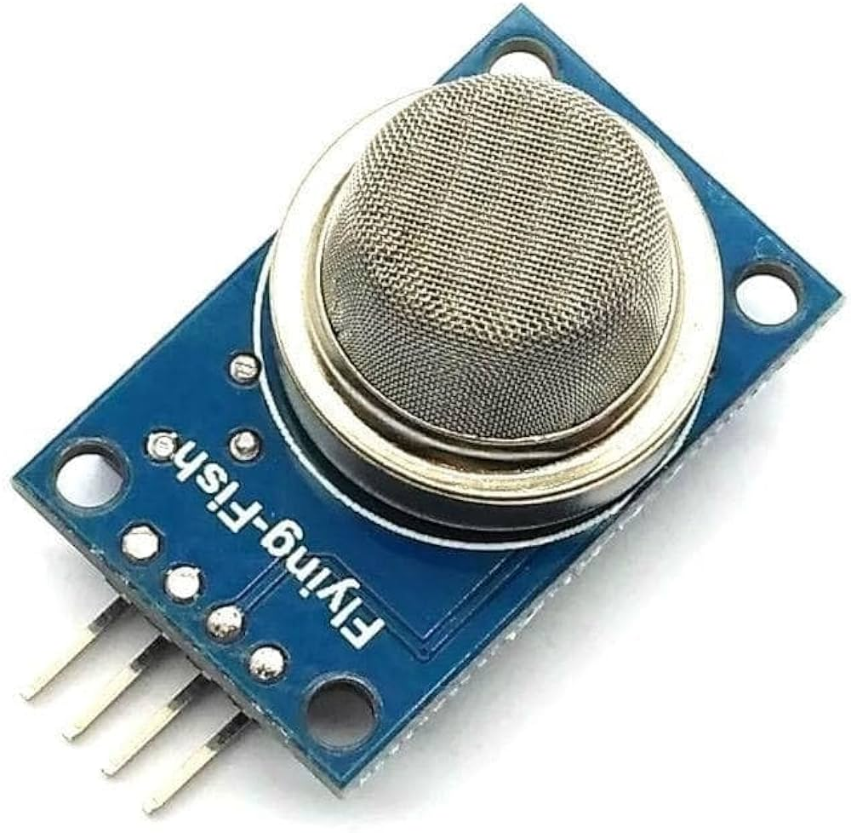
MQ2-SENSOR
Features:
Operating Voltage is +5V
Can be used to Measure or detect LPG, Alcohol, Propane, Hydrogen, CO and even methane
Analog output voltage: 0V to 5V
Digital Output Voltage: 0V or 5V (TTL Logic)
Preheat duration 20 seconds
Can be used as a Digital or analog sensor
The Sensitivity of Digital pin can be varied using the potentiometer.

Slide 7
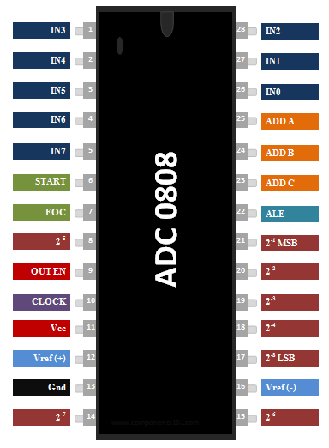
ADC0808
ADC0808 Features:
Easy to interface with all Microprocessors or works Stand alone.
Eight channel 8-bit ADC module
Can measure up to 8 Analog values seamlessly
On chip Clock not available, external Oscillator is needed (Clock)
Digital output various from 0 to 255, Operating power is 15mW, conversion time 100us
When Vref = 5V, for every 19.53mV of analog value there will be rise of one bit on digital side (Step size)
Available in 28-pin PDIP, SOIC packages.

Slide 8
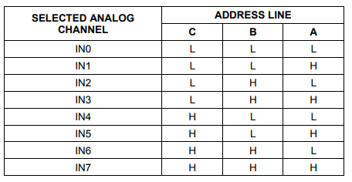
ADC0808
ADDRESS LINES:
The input analog voltage can be given to pins from IN1 to IN7, but the IC can read the voltage of only one channel at a time.
This channel selection can be done with the pins ADD A, ADD B and ADD C.
These three bits have to be set as shown in the table below to access the respective analog channel.
Once the channel is set it should be enabled by making the Address latch enabled (ALE) pin to go high momentarily.

Slide 9
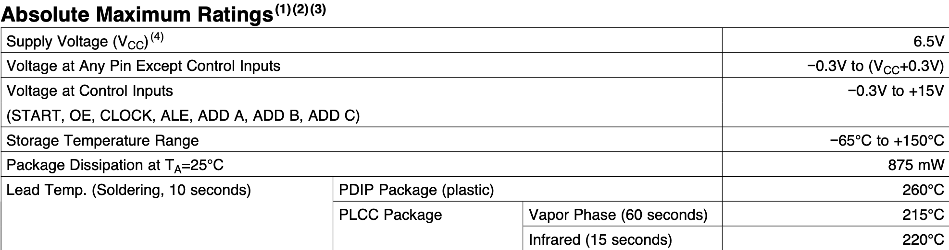
ADC0808
ADC Channel – IN0
PWM Channel – 1 (in microcontroller)
Clock frequency = 643KHz

Slide 10
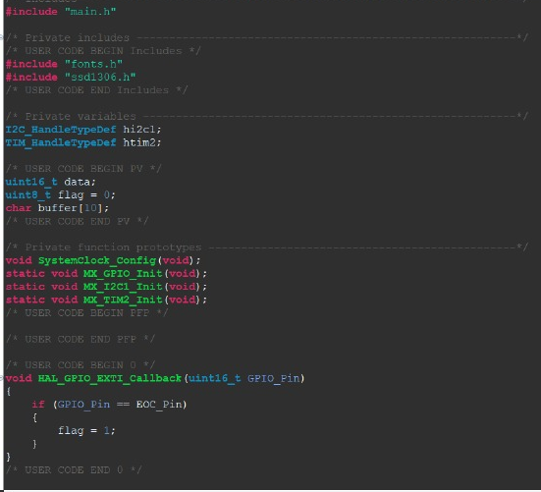
DISPLAY IN OLED

Slide 11
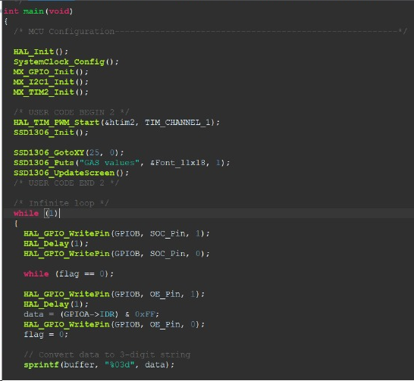
DISPLAY IN OLED

Slide 12
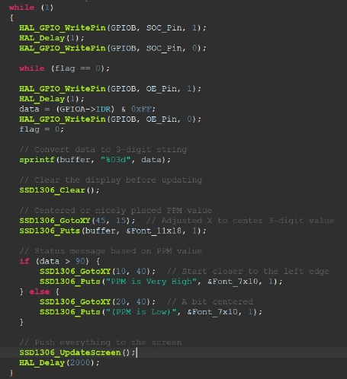
DISPLAY IN OLED

Slide 13
THANK YOU

